Slide 1

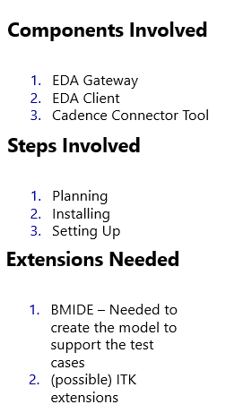
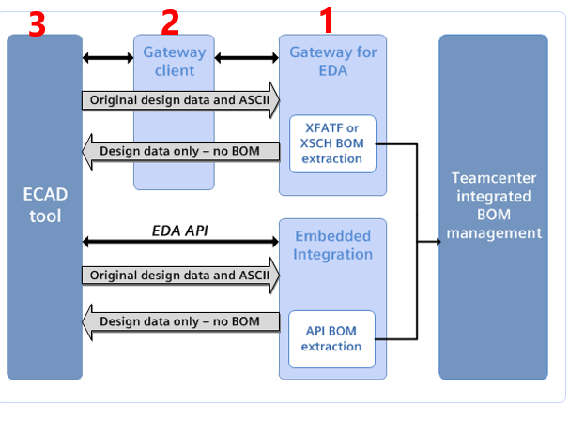
Integrated ECAD Architecture
EDA Gateway Overview, Process and Dataflow
1

